Slide 1
Business Stakeholders, Stake holders and issue analysis

Slide 2
The Stakeholder Concept and Business
Pluralistic society → influence or power is decentralized by dispersing it among a variety of institutions
  No one institution is completely independent of others
  Each institution has some autonomy to pursue own interests
Stakeholder → individual, or group, who can influence and/or is influenced by the achievement of an organization’s purpose
  Managers need to identify stakeholders for two reasons:
    To obtain resources
    To maintain legitimacy of business

Slide 3
The Stakeholder Concept and Business
Freeman (1984):
  Managers must seek out stakeholders
  If “you want to manage effectively, then you must take your stakeholders into account in a systematic fashion.”
Relationships are two-way:
  Corporations must understand how activities influence stakeholders
  Stakeholders must consider their responsibilities to the corporation
Notes:
This definition is based on the work of R. Edward Freeman in Strategic Management: A Stakeholder Approach (Boston: Pitman, 1984), 53.

Slide 4

Identifying Stakeholders
Owners
Directors
Employees
Customers or Consumers
Lenders and Creditors
Suppliers
Service Professionals
Dealers, Distributors, and Franchisees
Business Organizations
Competitors
Joint-Venture Participants

Slide 5
Categorizing Stakeholders
Frederick, Davis and Post:
  Primary interactions → with employees (unions), shareholders, creditors, suppliers, customers, competitors, wholesalers or retailers
  Secondary interactions → with local communities, governments, social activist groups, media, business support groups and the general public
Difficult to ascertain who should be on each list

Slide 6
Categorizing Stakeholders
Mintzberg:
  Stakeholders are categorized as being external vs. internal to the organization
  Helps conceptualize power in and around organizations
Phillips:
  Normative stakeholders → those to whom organization has an obligation and from whom corporation accepts benefits
  Derivative stakeholders → those from whom corporation has not accepted benefits, but they hold power over corporation

Slide 7
The Manager:
A Special Stakeholder Cont’d…
High CEO compensation raises ethical implications
Changing executive compensation:
  “Pay for performance” result in executives receiving large cash salaries + stock and equity-linked incentives
  Executives focus on shareholders (vs. other stakeholders)
  Contributes to income inequity
Sustainable pay → tying executive compensation to environmental, social, and governance performance targets

Slide 8
Issues Relating to Ethics, Responsibilities, and Sustainability
Issue → point in question where different views are held of what is or what ought to be corporate performance-based management or stakeholder expectations
Wartrick and Mahon expand:
  Controversial inconsistency based on expectation gaps
  Involving management perceptions of changing legitimacy
  Occur with or between views of what is and/or what ought to be corporate performance
  Imply an actual or anticipated resolution that creates significant impact on organization

Slide 9
Purpose of Issues
Management
Issues management → systemic process by which the corporation can identify, evaluate, and respond to economic, social, and environmental issues that may impact significantly upon it
Purpose:
  Minimize surprises relating to events or trends in society by serving as an early warning system
  Prompts managers to be more systematic in coping with issues and stakeholder concerns
  Mechanism for coordinating and integrating management of issues

Slide 10
Benefits of
Issues Management
Corporations more likely to maintain competitive advantage
Behaviour more consistent with societal expectations
Less likely to make a serious social or ethical mistake
Detect issues earlier and develop appropriate responses
Reduces vulnerability and enhances credibility

Slide 11
Stakeholder and Issue Analysis
Stakeholder engagement → efforts by corporation to understand and involve relevant individuals, groups, or organizations by considering their moral concerns
Issue analysis → effort to understand the source, nature, and extent of a question or matter in dispute facing corporation
  Will result in addressing or resolving the matter

Slide 12
Basic Stakeholder Analysis
Corporations can increase understanding of stakeholders by asking the following:
  Who are our stakeholders?
  What are their stakes?
  What opportunities and challenges are presented to our firm?
  What responsibilities does our firm have to all its stakeholders?
  What strategies or actions should our firm use deal with stakeholder challenges and opportunities?

Slide 13
Stakeholder Matrix
Mapping
Matrix mapping → technique of categorizing an organization’s stakeholders by their influence according to two variables and plotting them on a two-by-two matrix:
  Y Axis: Oppose or support corporation
  X Axis: Importance of stakeholders
Allows managers to:
  Assess power of stakeholders to achieve their demands
  Whether they have means or resources to influence

Slide 14
Stakeholder Matrix
Mapping Cont’d…
Four categories of stakeholders result from this analysis:
  Problematic stakeholders - those who would oppose the organization’s course of action and are relatively unimportant to the organization
  Antagonistic stakeholders - those who would oppose or be hostile to the organization’s course of action and are very important to the organization
Notes:
Sources: Based on Paul C. Nutt and Robert W. Backoff, Strategic Management of Public and Third Sector Organizations: A Handbook for Leaders (San Francisco: Jossey-Bass Publishers, 1992), 191; and John M. Bryson, Strategic Planning for Public and Nonprofit Organizations: A Guide to Strengthening and Sustaining Organizational Achievement, revised edition (San Francisco: Jossey-Bass Publishers, 1995), 284.

Slide 15
Stakeholder Matrix
Mapping Cont’d…
  Low priority stakeholders - those who support the organization’s course of action and are relatively unimportant to the organization.
  Supporter stakeholders - those who would support the organization’s course of action and are important to the organization
After categorization complete, managers can develop tactics and strategies to most appropriately deal with each stakeholder
Notes:
Sources: Based on Paul C. Nutt and Robert W. Backoff, Strategic Management of Public and Third Sector Organizations: A Handbook for Leaders (San Francisco: Jossey-Bass Publishers, 1992), 191; and John M. Bryson, Strategic Planning for Public and Nonprofit Organizations: A Guide to Strengthening and Sustaining Organizational Achievement, revised edition (San Francisco: Jossey-Bass Publishers, 1995), 284.

Slide 16
Ethics of business

Slide 17
Introducing the
Ethics of Business
Business ethics → rules, standards, codes, or principles that provide guidelines for morally right behaviour and truthfulness in specific situations
  Means different things to different managers

Slide 18
Assessment of Ethical
Implications in Business Decisions
Value judgments → subjective evaluations of what is considered important
  Based on how managers intuitively feel about the goodness or rightness of various goals
Moral standards → the means by which individuals judge their actions and the actions of others
  Based upon accepted behaviour in society

Slide 19
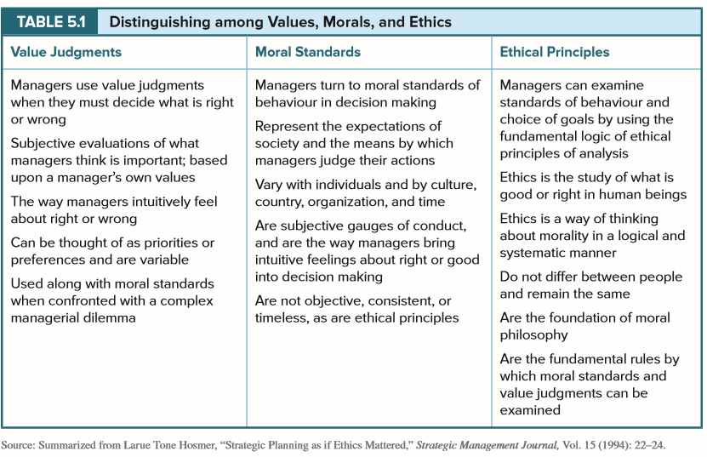
Distinguishing among
Values, Morals, and Ethics
TABLE 5.1

Slide 20
Self-Interest Ethic
(Ethical Egoism)
Individuals or corporations set their own standards for judging the ethical implications of their actions
  Individual’s values and standards are the basis for actions
Problems with self-interest ethic:
  Considered easy way out because person relies on own beliefs without more complicated analysis
  Viewed as selfish behaviour
  Leads to absolutism; failing to take into consideration interest of others

Slide 21
Self-Interest Ethic
(Ethical Egoism) Cont’d…
It is acceptable for an individual to be appropriately self-concerned as long as interests of others are considered
  Enlightened egoist – attentive to needs of others, and self-interest provides an incentive to restrain one’s self-interest
Maximization of profits is acceptable as long as interests of relevant stakeholders are considered
  Corporation must stay within rules of operation provided in society through government

Slide 22
Ethics of Caring
Gives attention to specific individuals or stakeholders harmed or disadvantaged and their particular circumstances
  Responsibility for reducing harm or suffering of others
  Solutions designed to respond to needs of particular individuals or stakeholders
Managers and corporations should act toward others in a way they would expect others to act toward them
  Golden rule: “Do unto others as you would have them do unto you”

Slide 23
Utilitarian Ethic
Focuses on the distribution of benefits and harms to all stakeholders with the view to maximizing benefits
  “The greatest good for the greatest number.”
Problems:
  Does not account for what is just
  What should be maximized to result in community’s happiness?
  Cannot accurately measure some costs and benefits (and/or risk of miscalculating them)
  No method for distributing costs or benefits

Slide 24
Universal Rules Ethic
Ensures that managers or corporations have the same moral obligations in morally similar situations
  “What individuals believe is right for themselves, they should believe is right for all others”
  Persons should be treated as end in themselves, worthy of dignity and respect and never as a mean’s to one’s own ends
  Categorical imperative ethics → rules and morals in society should be fair to everyone, they should universally apply and apply over time

Slide 25
Kohlberg’s Stages of Moral Development
Individuals have identifiable cognitive skill levels that they use in resolving moral dilemmas
  Developed over time as result of educational experience and the socialization process in maturing from childhood to adulthood
  Six stages of moral development divided into three levels:
    LEVEL I: Pre-Conventional Level (Self)
    LEVEL II: Conventional Level (Others)
    LEVEL III: Post-conventional Level (Humankind)

Slide 26
Kohlberg’s Stages of Moral Development Cont’d…
LEVEL I: Pre-conventional (Self)
  Stage 1 – Punishment and obedience orientation
  Stage 2 – Individual instrumental purpose/ exchange
LEVEL II: Conventional Level (Others)
  Stage 3 – Mutual interpersonal expectations
  Stage 4 – Law and order orientation
LEVEL III: Post-Conventional Level (Humankind)
  Stage 5 – Social contract orientation
  Stage 6 – Universal ethical principle orientation

Slide 27
Ethics in Business:
Some Challenges
Too simplistic approaches:
  Indicating “just do the right thing” is not satisfactory
Myths:
  It’s easy to be ethical
  Unethical behaviour in business is simply result of “bad apples”
  People are less ethical than they used to be
Lack of awareness:
  Most people believe that they behave ethically towards others, but self-perception often falls short
  Four biases: prejudice, favouritism, overclaiming credit and conflict of interest

Slide 28
Codes of Conduct and Ethics
Code of conduct → explicitly states what appropriate behaviour is by identifying what is acceptable and unacceptable
Code of ethics → a statement of principles or values that guide behaviour by describing the general value system within which a corporation attempts to operate in a given environment

Slide 29
Codes of Conduct and
Codes of Ethics Cont’d…
Content of codes has evolved over time and through five generations:
  First generation → conflict of interest
  Second generation → commercial conduct
  Third generation → employee rights and motivation of the workforce
  Fourth generation → wider responsibility, with attention on environment and respect for communities
  Fifth generation → international concerns, including human rights, the rule of law and labour conditions

Slide 30
Understanding
Conflicts of Interest
Conflict of interest → situation in which an individual has a private or personal interest that is sufficient to appear to influence the objective exercise of that individual’s duties
Three types of conflict:
  Real
  Apparent
  Potential

Slide 31
Common Conflicts of Interest
Self-dealing—Exists where a manager or employee takes an action in an official capacity that involves dealing with oneself in a private capacity and that confers a benefit to oneself. Today this extends to one’s spouse, family members, and business partners.
Accepting gifts or benefits—Involves the acceptance of some benefit.
Influence peddling—The practice of soliciting some form of benefit; for example, asking for a kickback or gift from a supplier if a purchase is made.
Using employer’s property—The inappropriate use of an employer’s property; for example, taking office supplies for home use.
Using confidential information—The use for personal or private purposes of confidential information obtained from some other source, for example customers or suppliers, to gain some benefit.
Outside employment or moonlighting—The work or activity in which an employee engages outside normal working hours for additional remuneration.
Post-employment—Subsequent or future employment where information or contacts obtained during employment results in some benefit.
Personal conduct—The situation where an employee’s behaviour in private life may reflect adversely on the employer.
TABLE 6.3

Slide 32
Ethics: Who is Responsible?
Boards of directors have two tasks in relation to ethics:
  To collectively identify values that determine acceptable behaviour in the firm
  Put in place a process that ensures values are reflected in action
Success of any ethics programs depends on commitment of top management:
  Announce the program
  Champion its development and implementation
  Aspire to lead in an ethical manner
Notes:
Archie B. Carroll, “The Moral Leader: Essential for Successful Corporate Citizenship,” in Jorg Andriof and Malcolm McIntosh, Perspectives on Corporate Citizenship (London: Greenleaf Publishing, 2002), 145–150.

Slide 33
Management and Leadership Models
Immoral | Amoral | Moral
A posture or approach that is devoid of ethical principles and actively opposed to what is moral Management’s motives are selfish and it cares only about the individual’s or the organization’s gains Management to some degree knows right from wrong and chooses to do wrong May be motivated by greed and profitability, and organizational (or personal) success is the goal to be achieved at any price Do not care about claims or expectations of others The law is regarded as a barrier to be overcome and will circumvent if it will achieve their ends Do not make good corporate citizens | A posture or approach that is without ethics, but not actively immoral Two types: intentionally or unintentionally amoral Intentionally amoral leaders do not consider ethics, as they believe business activity lies outside of moral judgments; neither moral nor immoral, as different rules apply to business Unintentionally amoral leaders are morally careless, unaware of or inattentive to impact of their decisions on others They lack ethical perception, sensitivity, or awareness May be well-intentioned but unaware of harms from their actions “Ethical gears in neutral” Use letter of the law instead of spirit Cannot make good corporate citizens | Conform to high standards of ethical behaviour or professional standards Aspire to succeed only within confines of ethical principles; for example fairness, justice, and due process Concerned with letter and spirit of the law Prefer standards that are higher than the minimum set by the law Assume leadership when ethical dilemmas arise Make ethics a driving force of the organization
TABLE 6.4
Notes:
Archie B. Carroll, “The Moral Leader: Essential for Successful Corporate Citizenship,” in Jorg Andriof and Malcolm McIntosh, Perspectives on Corporate Citizenship (London: Greenleaf Publishing, 2002), 145–150.

Slide 34
Corporate Social Responsibility

Slide 35

Describing Corporate
Social Responsibility (CSR)
The way a corporation achieves a balance among it economic, social, and environmental responsibilities in its operations so as to address shareholder and other stakeholder expectations

Slide 36
Key Elements of CSR
Five key elements found in most CSR definitions:
  Corporations have responsibilities beyond the production of goods and services
  These responsibilities involve helping to solve social problems, especially those they have helped create
  Corporations have a broader constituency than just shareholders alone
  Corporations have impacts that go beyond simple marketplace transactions
  Corporations serve a wider range of human values than can be captured by a sole focus on economic values

Slide 37
Describing CSR Cont’d…
Basic idea of CSR is that business and society are interwoven rather than distinct entities
Expectations are placed on business due to its three roles:
  As an institution in society
  As corporation or organization in society
  As individual managers who are moral actors within corporation
These three roles can be expressed in terms of three principles of corporate social responsibility: legitimacy; public responsibility; and managerial discretion
Source: Wood, 1991
Notes:
Donna J. Wood, “Corporate Social Performance Revisited,” The Academy of Management Review, Vol. 16, No. 4 (1991): 695.

Slide 38
Ethical Basis for CSR
Managers have different motivations when responding to sustainability → results in different sustainability management initiatives
  Four different kinds of business cases of or for sustainability:
    Reactionary – focusing on profit-seeking behaviour and minimizing costs
    Reputational – how the business is portrayed in media or society
    Responsible – striving for business excellence where corporation’s success is measured by economic, environmental, and social indicators
    Dialogue-based - engagement with broad range of stakeholders leads to collaboration and understanding of initiatives that will have social, environmental, and economic benefits

Slide 39
Social Responsibility
Theories: Three Categories
Amoral View:
  Traditional view of business as merely profit-making entity
Personal View:
  Corporations viewed as collectives that act as individuals; they exist as legal persons and can be held responsible for their actions
Social View:
  Corporations are social institutions in society, with social responsibilities
Source: Klonoski, 1991

Slide 40
The Pyramid of CSR
Carroll’s pyramid (1991):
  Four kinds of social responsibility depicted in a pyramid - economic responsibilities at bottom, followed by legal, ethical and philanthropic higher up
  Pyramid is basic building-block, with economic performance as foundation
  Corporation should strive to:
    Make a profit
    Obey the law
    Behave ethically and
    Be a good corporate citizen

Slide 41
Summary
These arguments are reflected in Klonoski’s summary of social responsibility theories, categorized according to three alternative views of the corporation as amoral, personal, and social. (LO 7.3)
A pyramid of corporate social responsibilities is presented, based on economic, legal, ethical, and philanthropic responsibilities. A hierarchy of responsibilities exists: economic and legal obligations are primary and basic. In recent years, the ethical and philanthropic responsibilities have received more attention. (LO 7.4)

Slide 42
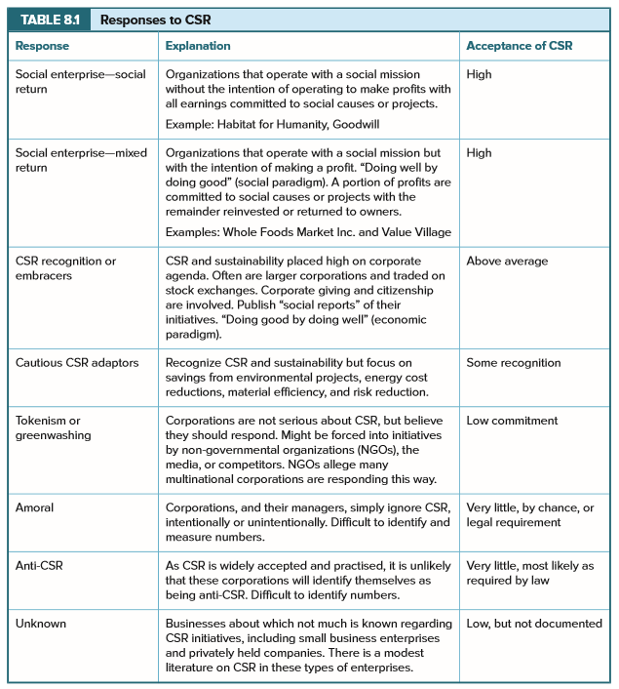
Responses to CSR
Response | Explanation | Acceptance of CSR
Social enterprise—social return | Organizations that operate with a social mission without the intention of operating to make profits with all earnings committed to social causes or projects. Example: Habitat for Humanity, Goodwill | High
Social enterprise—mixed return | Organizations that operate with a social mission but with the intention of making a profit. “Doing well by doing good” (social paradigm). A portion of profits are committed to social causes or projects with the remainder reinvested or returned to owners. Examples: Whole Foods Market Inc. and Value Village | High
CSR recognition or embracers | CSR and sustainability placed high on corporate agenda. Often are larger corporations and traded on stock exchanges. Corporate giving and citizenship are involved. Publish “social reports” of their initiatives. “Doing good by doing well” (economic paradigm). | Above average
Cautious CSR adaptors | Recognize CSR and sustainability but focus on savings from environmental projects, energy cost reductions, material efficiency, and risk reduction. | Some recognition
TABLE 8.1

Slide 43
Responses to CSR Cont’d…
Response | Explanation | Acceptance of CSR
Tokenism or greenwashing | Corporations are not serious about CSR, but believe they should respond. Might be forced into initiatives by non-governmental organizations (NGOs), the media, or competitors. NGOs allege many multinational corporations are responding this way. | Low commitment
Amoral | Corporations, and their managers, simply ignore CSR, intentionally or unintentionally. Difficult to identify and measure numbers. | Very little, by chance, or legal requirement
Anti-CSR | As CSR is widely accepted and practised, it is unlikely that these corporations will identify themselves as being anti-CSR. Difficult to identify numbers. | Very little, most likely as required by law
Unknown | Businesses about which not much is known regarding CSR initiatives, including small businesses and privately held corporations. There is a modest literature on CSR in these types of enterprises. | Low, but not documented
TABLE 8.1

Slide 44
Corporate Support and Policies
Majority of corporations support voluntary activities by:
  Providing facilities, allowing time off, assisting with personal expenses incurred while undertaking voluntary activities, special recognition to employees, letters of thanks, etc.
Policies on voluntarism are of three types:
  Encouraging
  Enabling
  Promoting
Voluntarism most successful where top management / CEO indicates it is worthy and commendable

Slide 45
Small Business and CSR
Challenges to implementing CSR in small businesses:
  Entrepreneurs do not have time to devote to CSR
  Expenses associated may be too high
  Lack of knowledge of CSR planning and monitoring
  Resources relevant to small businesses not readily available
Strongly influenced by personal values of entrepreneur
Small businesses must confront social and ethical issues experienced by large business

